Slide 1

BUSINESS
ENVIRONMENT

Slide 2

CHAPTER 1
BUSINESS

Slide 3
Definition of Business
“Business activities are all those human activities which are directed towards the production and procuring of wealth.”
- Prof. Haney

Slide 4
CHARACTERISTICS OF BUSINESS
Deals in goods and services
Two parties
Continuous process
Profit motive
Monetary exchange
Involves risk and uncertainty
Involves production and distribution

Slide 5
OBJECTIVES OF BUSINESS
ECONOMIC
OBJECTIVES
SOCIAL
OBJECTIVES
HUMAN OBJECTIVES
Creation of customers
Continuous
Innovations
Best possible use of resources
Production and supply of quality goods and services
Adoption of fair trade practices
Contribution to the general welfare of the society
Economic wellbeing of the employees
Social and psychological satisfaction of employees
Development of human resources
Wellbeing of socially and economically backward people

Slide 6
OBJECTIVES OF BUSINESS
NATIONAL OBJECTIVES
GLOBAL
OBJECTIVES
Creation of employment
Promotion of social justice
Production according to national priority
Contribute to the revenue of the country
Self-sufficiency and export promotion
Raise general standard of living
Reduce disparities among nations
Make available globally competitive goods and services

Slide 7
SCOPE OF BUSINESS
INDUSTRY
COMMERCE
Primary
Extractive
Genetic
Manufacturing
Construction
Service
IT
TRADE
AIDS TO TRADE
INTERNAL
EXTERNAL
Transport
Warehousing
Advertising & Salesmanship
Insurance
Mercantile agents & trader
Banking & Insurance
Retail
Wholesale
Import
Export
Entreport

Slide 8
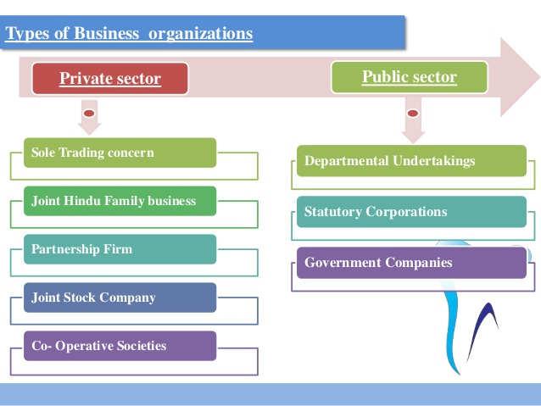

Slide 9
BUSINESS ENVIRONMENT

Slide 10
MEANING
Business vary in size, as measured by the number of employees or by sales volume etc. But, all businesses share one common purpose that is to earn profits.
Modern business is dynamic
If there is any single word than can best describe today’s business, it is change.
Environment factors are largely if not totally, external and beyond the control of individual industrial enterprises and their managements.
Business environment poses threats to a firm or offers immense opportunities for potential market exploitation.
The success of every business depends on adapting itself to the environment within which it functions.

Slide 11
CHARACTERISTICS OF BUSINESS ENVIRONMENT
Totality of external forces
Specific and general forces
Dynamic nature
Uncertainty
Relativity
Multifaceted

Slide 12
IMPORTANCE OF BUSINESS ENVIRONMENT
First mover advantage
Identification of threats
Coping with rapid changes
Improving performance
Giving direction for growth
Meeting competition
Image building
Continuous learning

Slide 13
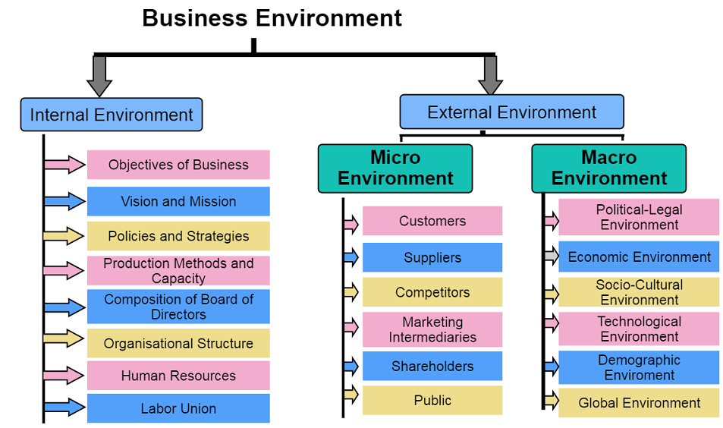
COMPONENTS OF BUSINESS ENVIRONMENT

Slide 14
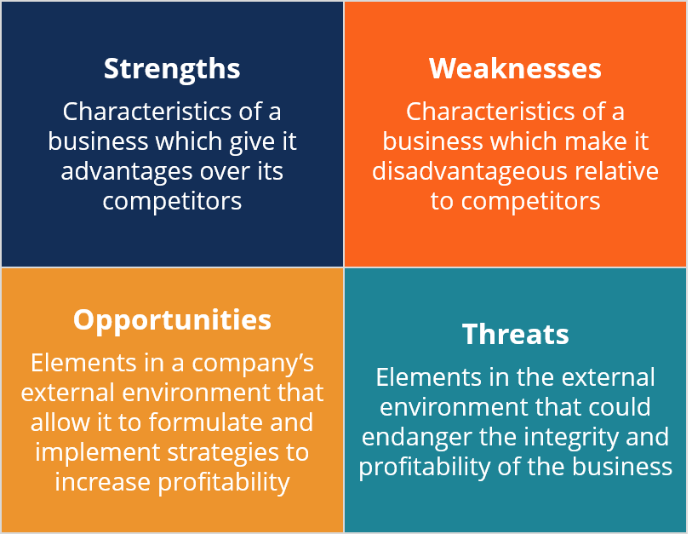
SWOT ANALYSIS

Slide 15
A SWOT Analysis is one of the most commonly used tools to assess the internal and external environments of a company and is part of a company’s strategic planning process.
In addition, a SWOT analysis can be done for a product, place, industry, or person.
A SWOT analysis helps with both strategic planning and decision-making, as it introduces opportunities to the company as a forward-looking bridge to generating strategic alternatives.
It s important to point out that strengths and weaknesses are current or backward-looking, and opportunities and threats are forward-looking. By performing a SWOT analysis, we will be able to build a bridge between what the company has accomplished to date and the strategic alternatives that are going to be generated.

Slide 16
Internal factors are the strengths and weaknesses of the company. Strengths are the characteristics that give the business its competitive advantage, while weaknesses are characteristics that a company needs to overcome in order to improve its performance.
Examples of internal factors include:
Company culture
Company image
Operational capacity
Brand awareness
Market share
Financial resources
Key staff

Slide 17
External factors are the opportunities and threats to the company. Opportunities are elements that the company sees in the external environment that it could pursue in the future to generate value. Threats are elements in the external environment that could prevent the company from achieving its goal or its mission or creating value.
Changes in the external environment may be due to:
Societal changes
Customers
Competitors
Economic environment
Suppliers
Partners

Slide 18
Conducting a SWOT Analysis
Strengths:
Consider strengths from an internal and consumer perspective.
What advantages does your company have?
What unique resources that you have that others do not?
What is your company’s Unique Selling Proposition?
What positive consumer perception does your company have?
What low-cost resources do you have access to that others do not?
Weaknesses:
Consider weaknesses from an internal and consumer perspective.
What does your company not do well?
What weaknesses do consumers see in your company?
What factors contribute to a weaker brand image?

Slide 19
Conducting a SWOT Analysis
Opportunities:
Consider opportunities from an external perspective.
What good opportunities are available in the marketplace?
What are some trends that your company can capitalize on?
Are there any changes in technology or markets that your company can take advantage of?
Are there any changes in lifestyle, social patterns, etc., that your company can take advantage of?
Threats:
Consider threats from an external perspective.
What obstacles does your company face?
What are your competitors doing better than you?
Is a change in technology threatening the position of your company?
What threats do your weaknesses put you at risk of?
Do changes in lifestyle, social patterns, etc., pose a threat to your company?

Slide 20

Example of a SWOT Analysis
Strengths:
McDonald’s serves customers in more countries than any other competitor in the fast-food industry
Significant economies of scale
Wide audience reach
McDonald’s exercises market power over suppliers and competitors
The most recognized brand in the fast-food industry
Competitive price
Weaknesses:
High employee turnover
Negative publicity (The perception of McDonald’s as an unhealthy food choice)
Not much variation in seasonal products
Quality inconsistency due to franchised operations
Focus on fast food and not healthier options for consumers

Slide 21
Example of a SWOT Analysis
Opportunities:
Being responsive to social changes to healthier options
Business expansion to new parts of the world
Allergen-free options and gluten-free food
Corporate social responsibility
Threats:
More health-conscious customers
Threat from competitors in different countries
Threat of an economic downturn
Social change to a more balanced meal

